Slide 1
Unit 6 Business Intelligence and Data Warehouses

Slide 2
Unit 6 - Business Intelligence and Data Warehouses
The Need for Data Analysis
Business Intelligence
Business Intelligence Architecture
Decision Support Data
Online Analytical Processing
Star Schemas
Implementing a Warehouse
Data Mining
SQL Extension for OLAP.

Slide 3
The Need for Data Analysis
Most managers want to be able to track daily transactions to evaluate how the business is performing.
Data analysis can provide information about short-term tactical evaluations and strategies such as
Are our sales promotions working?
What market percentage are we controlling?
Are we attracting new customers?

Slide 4
The Need for Data Analysis
Given the many and varied competitive pressures, managers are always looking for a competitive advantage through product development and maintenance, service, market positioning, sales promotion, and so on.
Companies and software vendors addressed these multilevel decision support needs by creating independent applications to fit the needs of particular areas. This more comprehensive and integrated decision support framework within organizations known as business intelligence.

Slide 5
Business Intelligence
Business intelligence (BI) is a term used to describe a comprehensive, cohesive, and integrated set of tools and processes used to capture, collect, integrate, store, and analyze data with the purpose of generating and presenting information used to support business decision making.
As the names implies, BI is about creating intelligence about a business. This intelligence is based on learning and understanding the facts about a business environment.
BI is a framework that allows a business to transform data into information, information into knowledge, and knowledge into wisdom.
BI is not a product by itself, but a framework of concepts, practices, tools, and technologies that help a business better understand its core capabilities, provide snapshots of the company situation, and identify key opportunities to create competitive advantage.

Slide 6
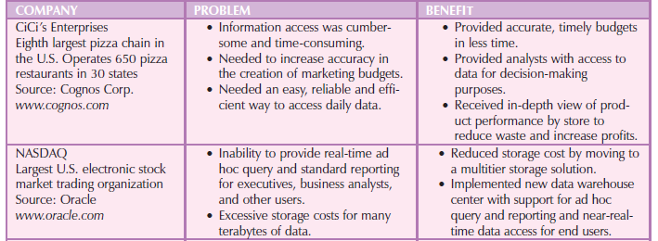
Companies - implemented BI tools

Slide 7
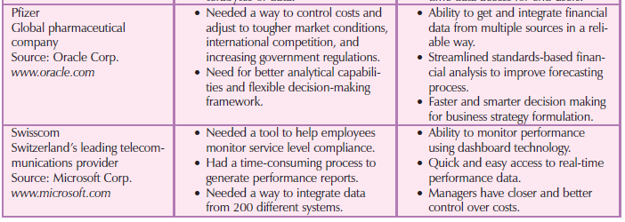
Companies - implemented BI tools

Slide 8
Business Intelligence
BI involves the following general steps:
1. Collecting and storing operational data.
2. Aggregating the operational data into decision support data.
3. Analyzing decision support data to generate information.
4. Presenting such information to the end user to support business decisions.
5. Making business decisions, which in turn generate more data that is collected, stored, etc. (restarting the process).
6. Monitoring results to evaluate outcomes of the business decisions (providing more data to be collected, stored, etc.).

Slide 9
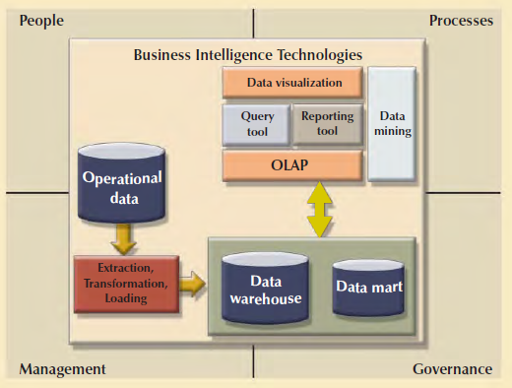
Business Intelligence Architecture

Slide 10
Business Intelligence Architecture
Business Intelligence Framework
The BI architecture is composed of data, people, processes, technology, and the management.
The main focus of BI is to gather, integrate, and store business data for the purpose of creating information
BI tools focus on the strategic and tactical use of information. Therefore, BI uses an arrangement of the best management practices to manage data as a corporate asset.

Slide 11
Business Intelligence Architecture
The use of master data management techniques. Master data management (MDM) is a collection of concepts, techniques, and processes for the proper identification, definition, and management of data elements within an organization.
MDM’s main goal is to provide a comprehensive and consistent definition of all data within an organization
MDM ensures that all company resources (people, procedures, and IT systems) that operate over data have uniform and consistent views of the company’s data.

Slide 12
Business Intelligence Architecture
An added benefit of this meticulous approach to data management and decision making is that it provides a framework for business governance. Governance is a method or process of government.
BI provides a method for controlling and monitoring business health and for consistent decision making.

Slide 13
Business Intelligence Architecture
BI makes extensive use of a special type of metrics known as key performance indicators.
Key performance indicators (KPI) are quantifiable measurements (numeric or scale based) that assess the company’s effectiveness or success in reaching its strategic and operational goals.
There are many different KPI used by different industries. Some examples of KPI are:
General : Year-to-year measurements of profit by line of business, same store sales, product turnovers, product recalls, sales by promotion, sales by employee, etc.
Finance : Earnings per share, profit margin, revenue per employee, percentage of sales to account receivables, assets to sales, etc.
Human resources : Applicants to job openings, employee turnover, employee longevity, etc.
Education : Graduation rates, number of incoming freshmen, student retention rates, etc.

Slide 14
Business Intelligence Architecture
Basic BI Architectural Components
ETL Tools
Data extraction, transformation, and loading (ETL) tools collect, filter, integrate, and aggregate operational data to be saved into a data store optimized for decision support.
Data store
The data store is optimized for decision support and is generally represented by a data warehouse or a data mart. The data store contains two main types of data: business data and business model data.
Data query and
analysis tools
This component performs data retrieval, data analysis, and data-mining tasks using the data in the data store. This component is used by the data analyst to create queries that access the database
Data presentation & visualization tools
This component is in charge of presenting the data to the end user in a variety of ways. This component is used by the data analyst to organize and present the data.

Slide 15
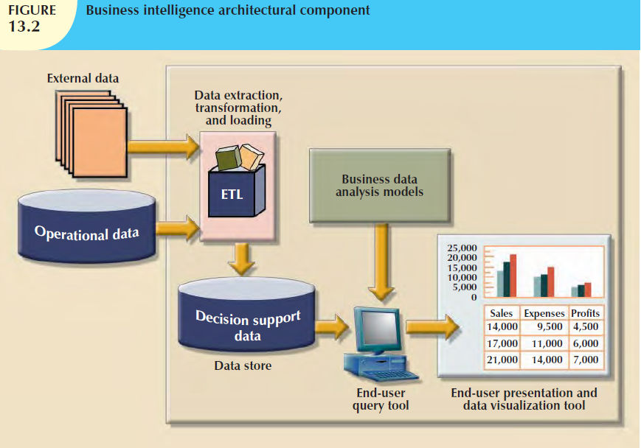
Business Intelligence Architecture

Slide 16
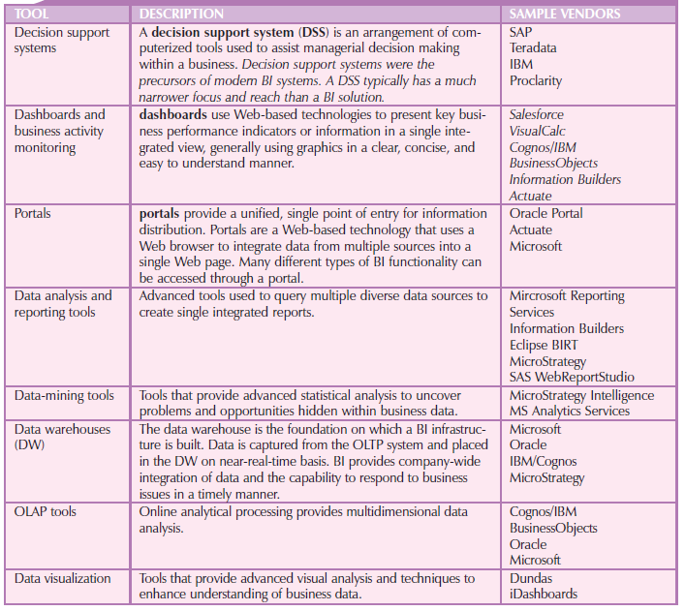
Sample of Business Intelligence Tools

Slide 17
Decision Support Data
Although BI is used at strategic and tactical managerial levels within organizations, its effectiveness depends on the quality of data gathered at the operational level.
Yet operational data are rarely well suited to the decision support tasks.

Slide 18
Operational Data vs. Decision Support Data
From the data analyst’s point of view, decision support data differ from operational data in three main areas: time span, granularity, and dimensionality.
Time span. Operational data cover a short time frame. In contrast, decision support data tend to cover a longer time frame.
Eg: Managers are rarely interested in a specific sales invoice to customer X; rather, they tend to focus on sales generated during the last month, the last year, or the last five years.

Slide 19
Operational Data vs. Decision Support Data
Granularity (level of aggregation). Decision support data must be presented at different levels of aggregation, from highly summarized to near-atomic.
For example, if managers must analyze sales by region, they must be able to access data showing the sales by region, by city within the region, by store within the city within the region, and so on. In that case, summarized data to compare the regions is required.

Slide 20
Operational Data vs. Decision Support Data
Dimensionality. Operational data focus on representing individual transactions rather than on the effects of the transactions over time. In contrast, data analysts tend to include many data dimensions and are interested in how the data relate over those dimensions.
For example, an analyst might want to know how product X fared relative to product Z during the past six months by region, state, city, store, and customer. In that case, both place and time are part of the picture.

Slide 21
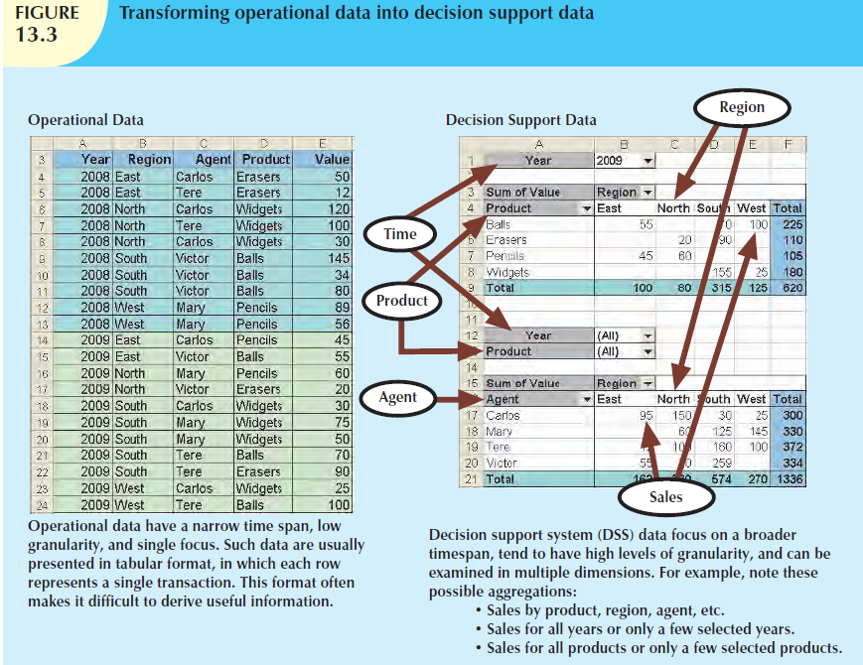

Slide 22
Operational Data vs. Decision Support Data
From the designer’s point of view, the differences between operational and decision support data are as follows:
Operational data represent transactions. Decision support data are a snapshot of the operational data at a given point in time. Therefore, decision support data are historic, representing a time slice of the operational data.
Operational and decision support data are different in terms of transaction type and transaction volume. Operational data are characterized by update transactions, decision support data are mainly characterized by query (read-only) transactions.
Decision support data also require periodic updates to load new data that are summarized from the operational data.

Slide 23
Operational Data vs. Decision Support Data
Operational data are commonly stored in many tables, and the stored data represent the information about a given transaction only. Decision support data are generally stored in a few tables that store data derived from the operational data.
The decision support data do not include the details of each operational transaction. Instead, decision support data represent transaction summaries; therefore, the decision support database stores data that are integrated, aggregated, and summarized for decision support purposes.

Slide 24
Operational Data vs. Decision Support Data
The degree to which decision support data are summarized is very high when contrasted with operational data.
For example, rather than storing all 10,000 sales transactions for a given store on a given day, the decision support database might simply store the total number of units sold and the total sales dollars generated during that day.
Decision support data might be collected to monitor such aggregates as total sales for each store or for each product.
The purpose of the summaries is simple: they are to be used to establish and evaluate sales trends, product sales comparisons, and so on, that serve decision needs. (How well are items selling? Should this product be discontinued? Has the advertising been effective as measured by increased sales?)

Slide 25
Operational Data vs. Decision Support Data
The data models that govern operational data and decision support data are different.
The operational database’s frequent and rapid data updates make data anomalies a potentially overwhelming problem.
In contrast, the decision support database is not subject to such transaction updates, and the focus is on querying capability. Therefore, decision support databases tend to be non-normalized and include few tables, each of which contains a large number of attributes.
Queries against operational data typically are narrow in scope, low in complexity, and speed-critical.
In contrast, decision support data exist for the sole purpose of serving query requirements. Queries against decision support data typically are broad in scope, high in complexity, and less speed-critical.

Slide 26
Operational Data vs. Decision Support Data
Finally, decision support data are characterized by very large amounts of data. The large data volume is the result of two factors. First, data are stored in non-normalized structures that are likely to display many data redundancies and duplications.
Second, the same data can be categorized in many different ways to represent different snapshots. For example, sales data might be stored in relation to product, store, customer, region, and manager.

Slide 27
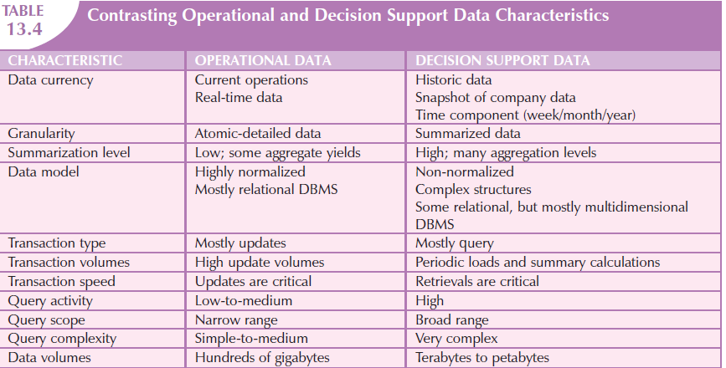
Operational Data vs. Decision Support Data

Slide 28
Decision Support Database Requirements
A decision support database is a specialized DBMS, customized to provide fast answers to complex queries.
There are four main requirements for a decision support database:
the database schema,
data extraction and loading,
the end-user analytical interface, and
database size

Slide 29
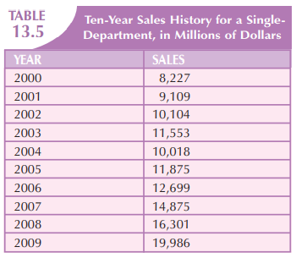
Decision Support Database Requirements
Database Schema: The decision support database schema must support complex (non-normalized) data representations. The decision support database must contain data that are aggregated and summarized.

Slide 30
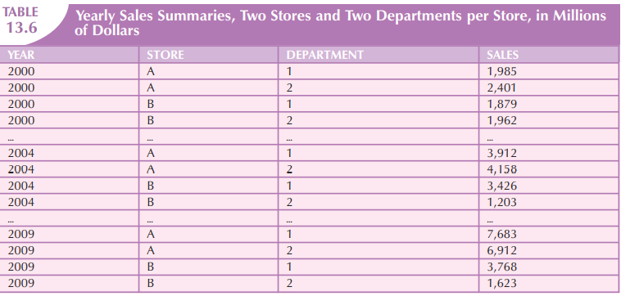
Decision Support Database Requirements

Slide 31
Decision Support Database Requirements
Data Extraction and Filtering :The decision support database is created largely by extracting data from the operational database and by importing additional data from external sources.
To minimize the impact on the operational database, the data extraction capabilities should allow batch and scheduled data extraction.
The data extraction capabilities should also support different data sources: flat files and hierarchical, network, and relational databases, as well as multiple vendors.
Data-filtering capabilities must include the ability to check for inconsistent data or data validation rules.
Finally, to filter and integrate the operational data into the decision support database, the DBMS must support advanced data integration, aggregation, and classification

Slide 32
Decision Support Database Requirements
End-User Analytical Interface: The decision support DBMS must support advanced data-modeling and data presentation tools.
Using those tools makes it easy for data analysts to define the nature and extent of business problems.
Once the problems have been defined, the decision support DBMS must generate the necessary queries to retrieve the appropriate data from the decision support database.

Slide 33
Decision Support Database Requirements
Database Size: Decision support databases tend to be very large; gigabyte and terabyte ranges are not unusual.
For example, in 2008, Wal-Mart, the world’s largest company, had more than 4 petabytes of data in its data warehouses.
The decision support database typically contains redundant and duplicated data to improve data retrieval and simplify information generation.
Therefore, the DBMS must be capable of supporting very large databases (VLDBs). To support a VLDB adequately, the DBMS might be required to use advanced hardware, such as multiple disk arrays, and to support multiple-processor technologies, such as a symmetric multiprocessor (SMP) or a massively parallel processor (MPP)

Slide 34
Online Analytical Processing (OLAP)
The need for more intensive decision support prompted the introduction of a new generation of tools.
Those new tools, called online analytical processing (OLAP), create an advanced data analysis environment that supports decision making, business modeling, and operations research.
OLAP systems share four main characteristics:
They use multidimensional data analysis techniques.
They provide advanced database support.
They provide easy-to-use end-user interfaces.
They support the client/server architecture.

Slide 35
OLAP - Multidimensional Data Analysis Techniques
The most distinctive characteristic of modern OLAP tools is their capacity for multidimensional analysis.
In multidimensional analysis, data are processed and viewed as part of a multidimensional structure.
This type of data analysis is particularly attractive to business decision makers because they tend to view business data as data that are related to other business data.

Slide 36
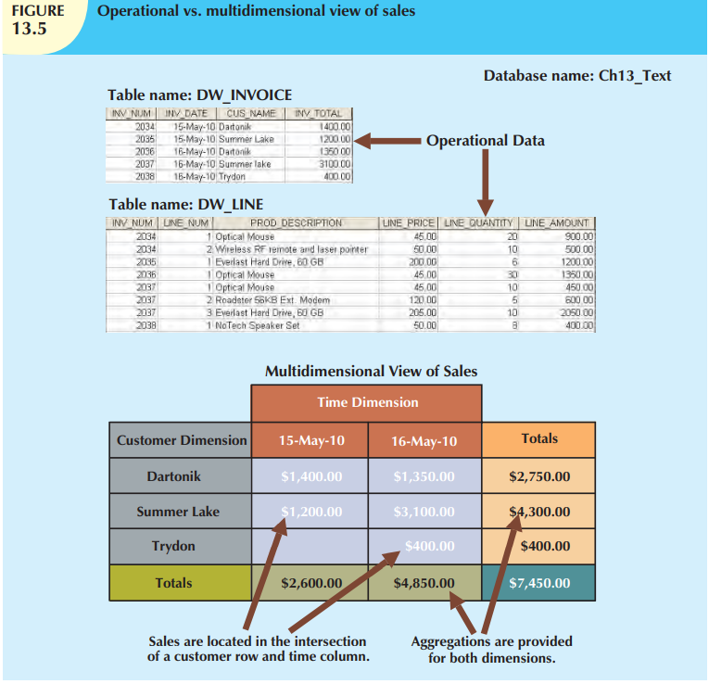

Slide 37
OLAP - Multidimensional Data Analysis Techniques
Multidimensional data analysis techniques are augmented by the following functions:
Advanced data presentation functions. 3-D graphics, pivot tables, crosstabs, data rotation, and three dimensional cubes. Such facilities are compatible with desktop spreadsheets, statistical packages, and query and report packages.
Advanced data aggregation, consolidation, and classification functions. These allow the data analyst to create multiple data aggregation levels, slice and dice data, and drill down and roll up data across different dimensions and aggregation levels.
For example, aggregating data across the time dimension (by week, month, quarter, and year) allows the data analyst to drill down and roll up across time dimensions.
Advanced computational functions. These include business-oriented variables (market share, period comparisons, sales margins, product margins, and percentage changes), financial and accounting ratios (profitability, overhead, cost allocations, and returns), and statistical and forecasting functions.
These functions are provided automatically, and the end user does not need to redefine their components each time they are accessed.
Advanced data-modeling functions. These provide support for what-if scenarios, variable assessment, variable contributions to outcome, linear programming, and other modeling tools

Slide 38
OLAP - Advanced Database Support
To deliver efficient decision support, OLAP tools must have advanced data access features. Such features include:
Access to many different kinds of DBMSs, flat files, and internal and external data sources.
Access to aggregated data warehouse data as well as to the detail data found in operational databases.
Advanced data navigation features such as drill-down and roll-up.
Rapid and consistent query response times.
The ability to map end-user requests, expressed in either business or model terms, to the appropriate data source and then to the proper data access language (usually SQL).
Support for very large databases. As already explained, the data warehouse can easily and quickly grow to multiple gigabytes and even terabytes.

Slide 39
OLAP - Easy-to-use End-user Interfaces
Advanced OLAP features become more useful when access to them is kept simple.
OLAP tool vendors learned this lesson early and have equipped their sophisticated data extraction and analysis tools with easy-to-use graphical interfaces.
Many of the interface features are “borrowed” from previous generations of data analysis tools that are already familiar to end users.
This familiarity makes OLAP easily accepted and readily used

Slide 40
OLAP - Client/Server Architecture
Client/server architecture provides a framework within which new systems can be designed, developed, and implemented.
The client/server environment enables an OLAP system to be divided into several components that define its architecture.
Those components can then be placed on the same computer, or they can be distributed among several computers.
Thus, OLAP is designed to meet ease-of-use requirements while keeping the system flexible.

Slide 41
OLAP - Architecture
OLAP operational characteristics can be divided into three main modules:
Graphical user interface (GUI).
Analytical processing logic.
Data-processing logic.

Slide 42
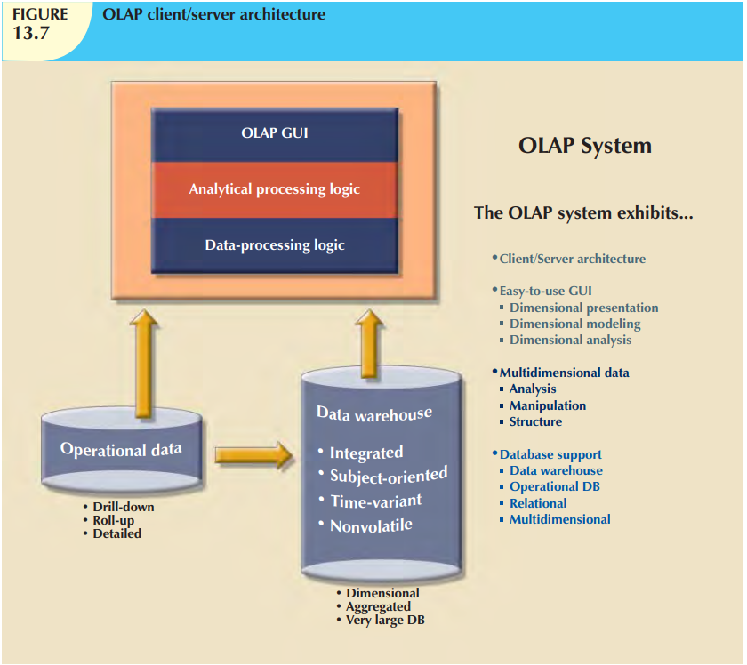

Slide 43
OLAP’s Client/Server Architecture
OLAP systems are designed to use both operational and data warehouse data.
A more common and practical architecture is one in which the OLAP GUI runs on client workstations, while the OLAP engine, or server, composed of the OLAP analytical processing logic and OLAP data-processing logic, runs on a shared computer.
In that case, the OLAP server will be a front end to the data warehouse’s decision support data.
This front end or middle layer accepts and processes the data-processing requests generated by the many end-user analytical tools.
The end-user GUI might be a custom-made program or, more likely, a plug-in module that is integrated with spreadsheet software or a third-party data analysis and query tool.
Figure 13.8 illustrates such an arrangement.

Slide 44
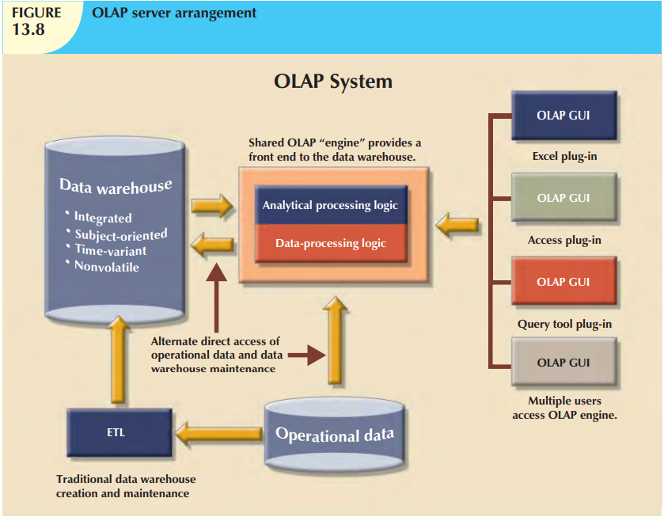

Slide 45
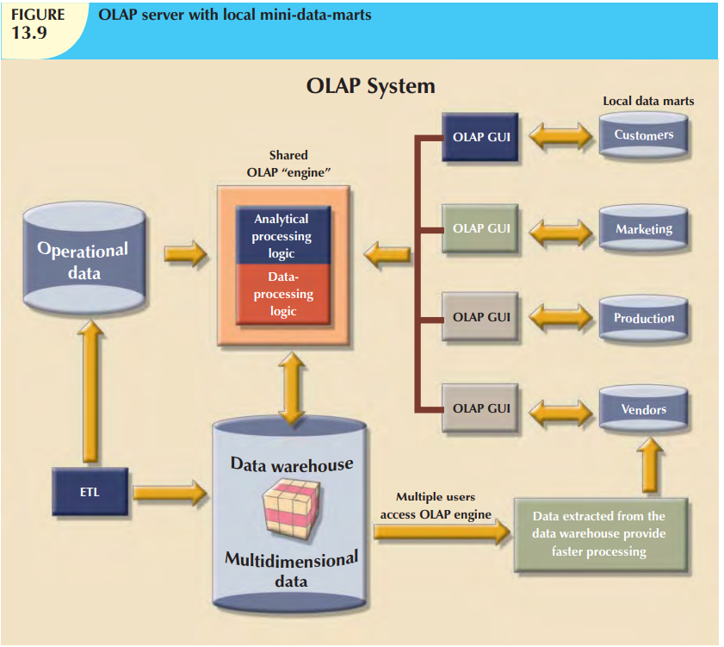

Slide 46
Star Schema
The star schema is a data-modeling technique used to map multidimensional decision support data into a relational database.
The basic star schema has four components:
facts,
dimensions,
attributes, and
attribute hierarchies

Slide 47
Star Schema - Facts
Facts are numeric measurements (values) that represent a specific business aspect or activity.
For example, sales figures are numeric measurements that represent product and/or service sales.
Facts commonly used in business data analysis are units, costs, prices, and revenues.
Facts are normally stored in a fact table that is the center of the star schema.
The fact table contains facts that are linked through their dimensions.
Facts can also be computed or derived at run time. Such computed or derived facts are sometimes called metrics to differentiate them from stored facts.
The fact table is updated periodically (daily, weekly, monthly, and so on) with data from operational databases.

Slide 48
Star Schema - Dimensions
Dimensions are qualifying characteristics that provide additional perspectives to a given fact.
For instance, sales might be compared by product from region to region and from one time period to the next.
For example, sales have product, location, and time dimensions.
In effect, dimensions are the magnifying glass through which you study the facts.
Such dimensions are normally stored in dimension tables.
Figure 13.12 depicts a star schema for sales with product, location, and time dimensions

Slide 49
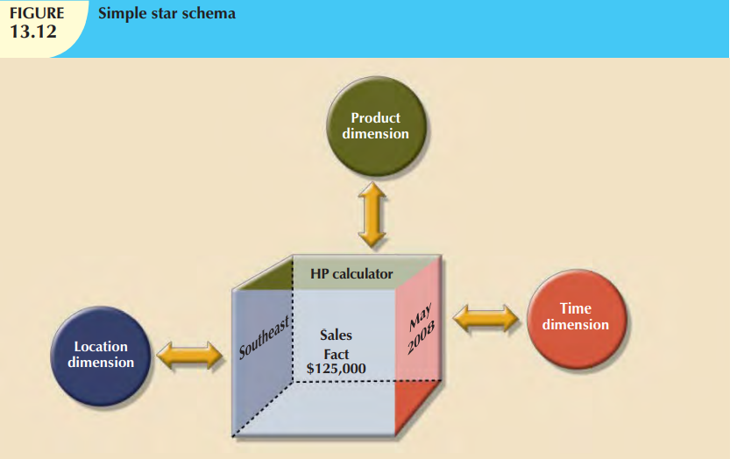

Slide 50
Star Schema - Attributes
Each dimension table contains attributes.
Attributes are often used to search, filter, or classify facts.
Dimensions provide descriptive characteristics about the facts through their attributes.
Therefore, the data warehouse designer must define common business attributes that will be used by the data analyst to narrow a search, group information, or describe dimensions.
Using a sales example, some possible attributes for each dimension are illustrated in Table 13.11.

Slide 51
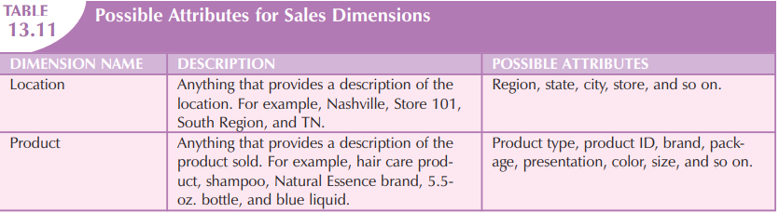
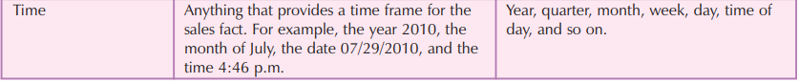
Star Schema - Attributes

Slide 52
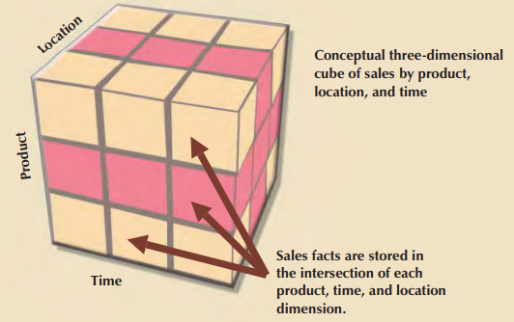
Star Schema - Attributes
The sales example’s multidimensional data model is best represented by a three-dimensional cube.
There is no mathematical limit to the number of dimensions used.
However, using a three-dimensional model makes it easy to visualize the problem.
In this three-dimensional example, the multidimensional data analysis terminology, the cube illustrated in Figure represents a view of sales dimensioned by product, location, and time.

Slide 53
Star Schema - Attributes
One of the main features of multidimensional analysis is its ability to focus on specific “slices” of the cube.
For example, the product manager may be interested in examining the sales of a product while the store manager is interested in examining the sales made by a particular store.
In multidimensional terms, the ability to focus on slices of the cube to perform a more detailed analysis is known as slice and dice.
Figure 13.14 illustrates the slice-and-dice concept. Each cut across the cube yields a slice. Intersecting slices produce small cubes that constitute the “dice” part of the “slice-and-dice” operation.

Slide 54
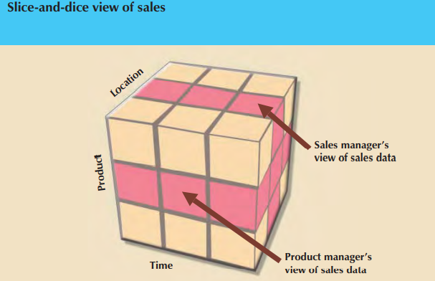
Star Schema - Attributes
To slice and dice, it must be possible to identify each slice of the cube.
That is done by using the values of each attribute in a given dimension.
For example, to use the location dimension, you might need to define a STORE_ID attribute in order to focus on a particular store

Slide 55
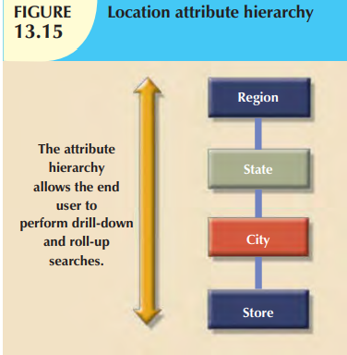
Star Schema – Attribute Hierarchies
Attributes within dimensions can be ordered in a well-defined attribute hierarchy.
The attribute hierarchy provides a top-down data organization that is used for two main purposes: aggregation and drill-down/roll-up data analysis.
For example, Figure 13.15 shows how the location dimension attributes can be organized in a hierarchy by region, state, city, and store.

Slide 56
Star Schema – Attribute Hierarchies
The attribute hierarchy provides the capability to perform drill-down and roll-up searches in a data warehouse.
For example, suppose a data analyst looks at the answers to the query: How does the 2009 month-to-date sales performance compare to the 2010 month-to-date sales performance?
The data analyst spots a sharp sales decline for March 2010.
The data analyst might decide to drill down inside the month of March to see how sales by regions compared to the previous year.
By doing that, the analyst can determine whether the low March sales were reflected in all regions or in only a particular region.
This type of drill-down operation can even be extended until the data analyst identifies the store that is performing below the norm.

Slide 57
Star Schema – Attribute Hierarchies
Figure 13.16 illustrates a scenario in which the data analyst studies sales facts, using the product, time, and location dimensions.
In this example, the product dimension is set to “All products,” meaning that the data analyst will see all products on the y-axis.
The time dimension (x-axis) is set to “Quarter,” meaning that the data are aggregated by quarters (for example, total sales of products A, B, and C in Q1, Q2, Q3, and Q4).
Finally, the location dimension is initially set to “Region,” thus ensuring that each cell contains the total regional sales for a given product in a given quarter.

Slide 58
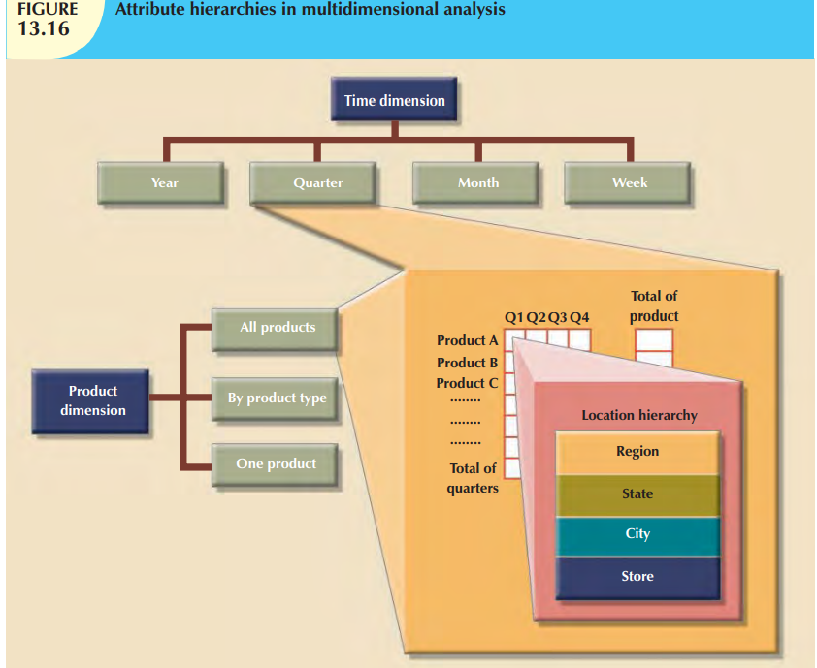

Slide 59
Star Schema Representation
Facts and dimensions are normally represented by physical tables in the data warehouse database.
The fact table is related to each dimension table in a many-to-one (M:1) relationship.
Fact and dimension tables are related by foreign keys and are subject to the familiar primary key/foreign key constraints.
The primary key on the “1” side, the dimension table, is stored as part of the primary key on the “many” side, the fact table.
Because the fact table is related to many dimension tables, the primary key of the fact table is a composite primary key.

Slide 60
Star Schema Representation
Figure 13.17 illustrates the relationships among the sales fact table and the product, location, and time dimension tables.
To show you how easily the star schema can be expanded, a customer dimension has been added to the mix.
Adding the customer dimension merely required including the CUST_ID in the SALES fact table and adding the CUSTOMER table to the database.

Slide 61
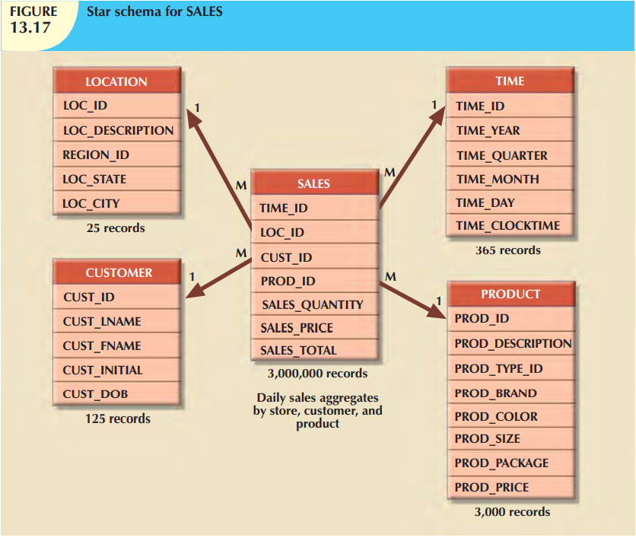

Slide 62
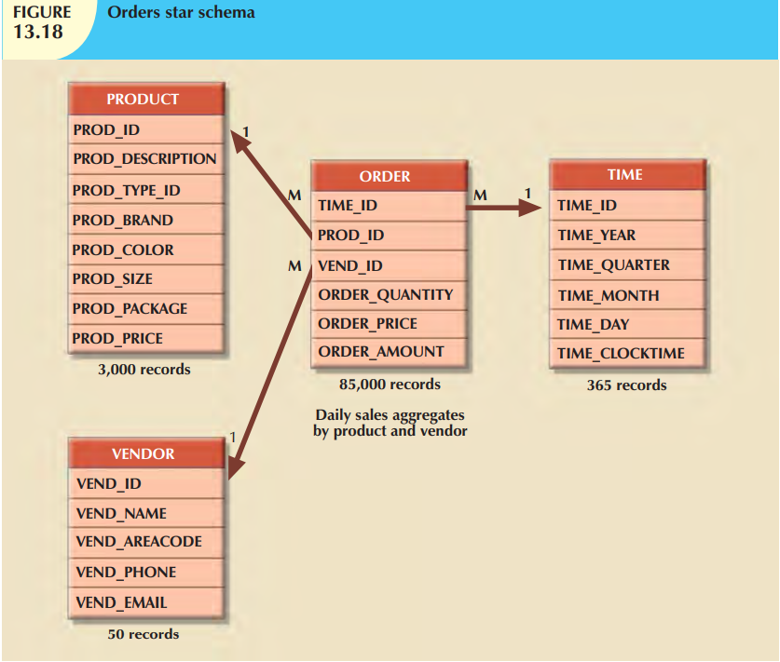

Slide 63
Implementing a Data Warehouse
The Data Warehouse as an Active Decision Support Framework:
Data warehouse is not a static database. Instead, it is a dynamic framework for decision support that is, almost by definition, always a work in progress.
The decision support infrastructure includes hardware, software, people, and procedures, as well as data.
The data warehouse is a critical component of a modern BI environment.

Slide 64
Implementing a Data Warehouse
A Company-Wide Effort That Requires User Involvement: Building the perfect data warehouse is not just a matter of knowing how to create a star schema;
it requires managerial skills to deal with conflict resolution, mediation, and arbitration.
In short, the designer must:
Involve end users in the process.
Secure end users’ commitment from the beginning.
Solicit continuous end-user feedback.
Manage end-user expectations.
Establish procedures for conflict resolution

Slide 65
Implementing a Data Warehouse
Satisfy the Trilogy: Data, Analysis, and Users - Great managerial skills are not, of course, solely sufficient.
The technical aspects of the data warehouse must be addressed as well.
The data warehouse designer must satisfy:
Data integration and loading criteria.
Data analysis capabilities with acceptable query performance.
End-user data analysis needs.

Slide 66
Implementing a Data Warehouse
Apply Database Design Procedures - design procedures must then be adapted to fit the data warehouse requirements.
The data warehouse derives its data from operational databases
It’s difficult to produce good data warehouse data when the operational database data are corrupted.
Figure 13.21 depicts a simplified process for implementing the data warehouse.

Slide 67
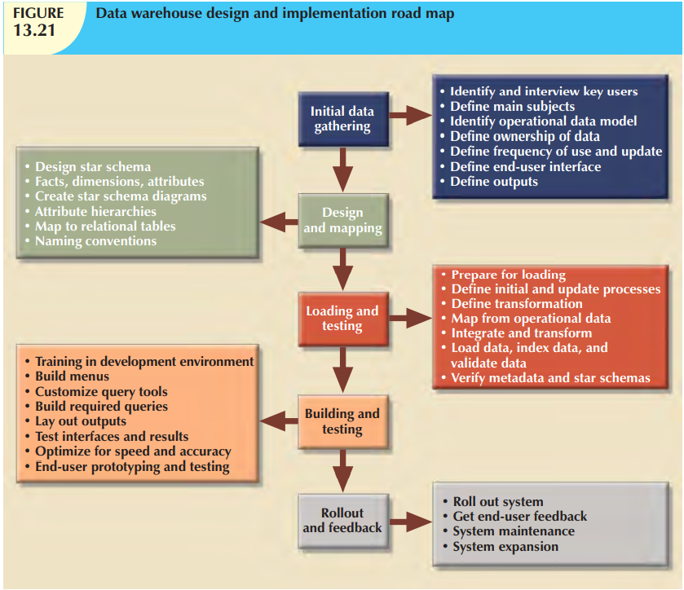

Slide 68
Data Mining
Data mining refers to the activities that
analyze the data,
uncover problems or opportunities hidden in the data relationships,
form computer models based on their findings, and
then use the models to predict business behavior—requiring minimal end-user intervention.
Therefore, the end user is able to use the system’s findings to gain knowledge that might yield competitive advantages .
In short, data-mining tools initiate analysis to create knowledge. Such knowledge can be used to address any number of business problems.
For example, banks and credit card companies use knowledge-based analysis to detect fraud, thereby decreasing fraudulent transactions.

Slide 69
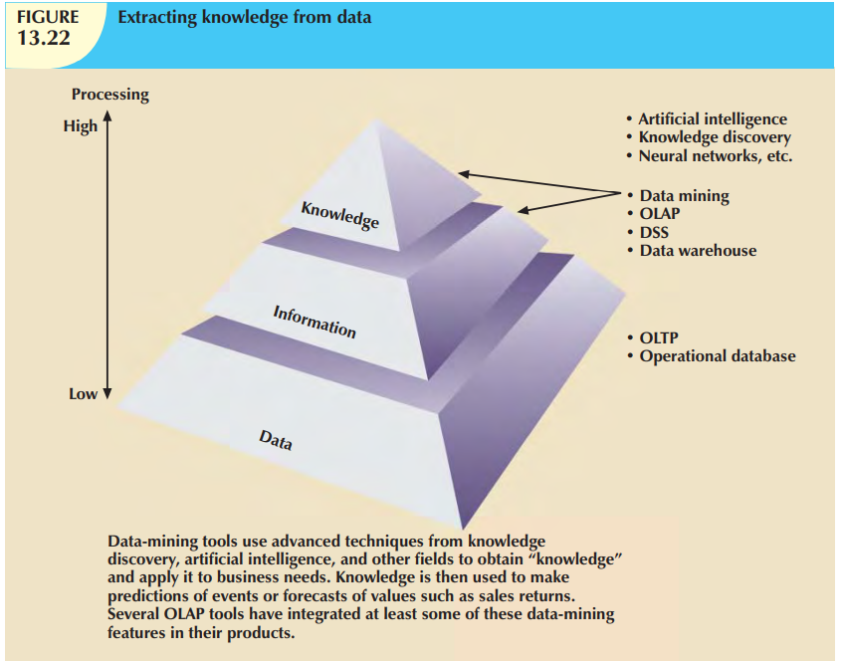

Slide 70
Data Mining
Data mining is subject to four general phases:
1. Data preparation.
2. Data analysis and classification.
3. Knowledge acquisition.
4. Prognosis.

Slide 71
Data Mining
In the data preparation phase, the main data sets to be used by the data-mining operation are identified and cleansed of any data impurities.
Because the data in the data warehouse are already integrated and filtered, the data warehouse usually is the target set for data-mining operations.
The data analysis and classification phase studies the data to identify common data characteristics or patterns.
During this phase, the data-mining tool applies specific algorithms to find:
Data groupings, classifications, clusters, or sequences.
Data dependencies, links, or relationships.
Data patterns, trends, and deviations

Slide 72
Data Mining
The knowledge acquisition phase uses the results of the data analysis and classification phase.
During the knowledge acquisition phase, the data-mining tool (with possible intervention by the end user) selects the appropriate modeling or knowledge acquisition algorithms.
The most common algorithms used in data mining are based on neural networks, decision trees, rules induction, genetic algorithms, classification and regression trees, memory-based reasoning, and nearest neighbor and data visualization.
A data-mining tool may use many of these algorithms in any combination to generate a computer model that reflects the behavior of the target data set.

Slide 73
Data Mining
Prognosis phase: the data-mining findings are used to predict future behavior and forecast business outcomes.
Examples of data-mining findings can be:
Sixty-five percent of customers who did not use a particular credit card in the last six months are 88 percent likely to cancel that account.
Eighty-two percent of customers who bought a 42-inch or larger LCD TV are 90 percent likely to buy an entertainment center within the next four weeks.
If age < 30 and income <= 25,000 and credit rating < 3 and credit amount > 25,000, then the minimum loan term is 10 years.
The complete set of findings can be represented in a decision tree, a neural net, a forecasting model, or a visual presentation interface that is used to project future events or results.
For example, the prognosis phase might project the likely outcome of a new product rollout or a new marketing promotion.

Slide 74
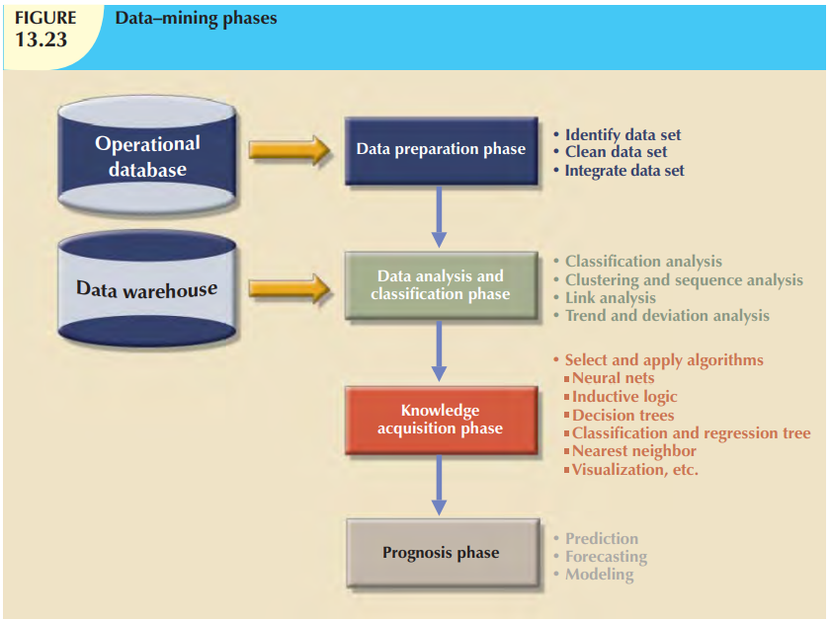

Slide 75
SQL EXTENSIONS FOR OLAP
The creation of OLAP tools has fostered the development of SQL extensions to support multidimensional data analysis. Most SQL innovations are the result of vendor-centric product enhancements.
The SaleCo snowflake schema shown in Figure 13.24 will be used to demonstrate the use of the SQL extensions.
This snowflake schema has a central DWSALESFACT fact table and three-dimension tables: DWCUSTOMER, DWPRODUCT, and DWTIME.
The central fact table represents daily sales by product and customer.

Slide 76
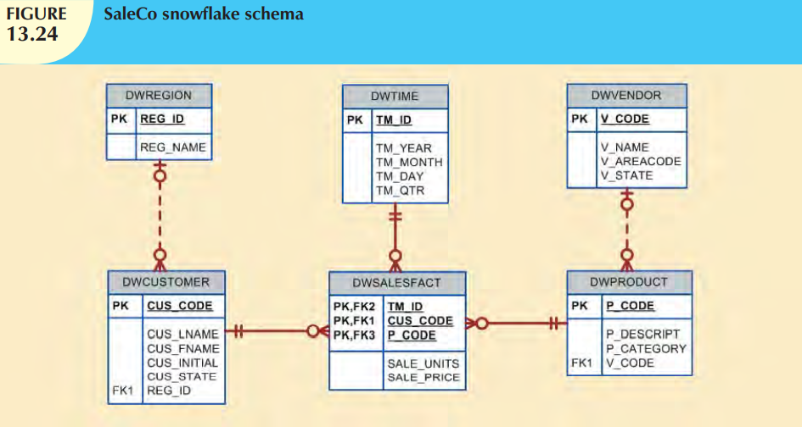

Slide 77
SQL EXTENSIONS FOR OLAP
ROLLUP extension: is used with the GROUP BY clause to generate aggregates by different dimensions.
The ROLLUP extension enables you to get a subtotal for each column listed except for the last one, which gets a grand total instead.
The syntax of the GROUP BY ROLLUP is as follows:
SELECT column1, column2 [, ...], aggregate_function(expression)
FROM table1 [,table2, ]
[WHERE condition]
GROUP BY ROLLUP (column1, column2 [, ...])
[HAVING condition]
[ORDER BY column1 [, column2, ]]
The order of the column list within the GROUP BY ROLLUP is very important.
The last column in the list will generate a grand total. All other columns will generate subtotals.

Slide 78
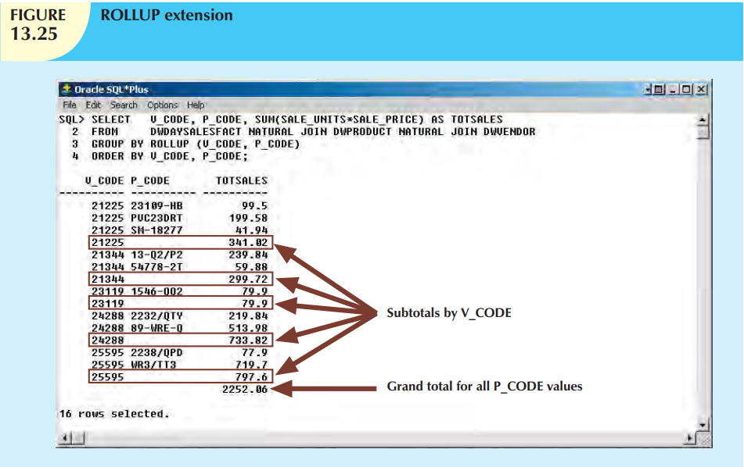
Use of the ROLLUP extension to generate subtotals by vendor and product

Slide 79
SQL EXTENSIONS FOR OLAP
CUBE extension: is also used with the GROUP BY clause to generate aggregates by the listed columns, including the last one.
The CUBE extension will enable you to get a subtotal for each column listed in the expression, in addition to a grand total for the last column listed.
The syntax of the GROUP BY CUBE is as follows:
SELECT column1 [, column2, ...], aggregate_function(expression)
FROM table1 [,table2, ]
[WHERE condition]
GROUP BY CUBE (column1, column2 [, ])
[HAVING condition]
[ORDER BY column1 [, column2, ]]
The CUBE extension is particularly useful when you want to compute all possible subtotals within groupings based on multiple dimensions.
Cross-tabulations are especially good candidates for application of the CUBE extension.

Slide 80
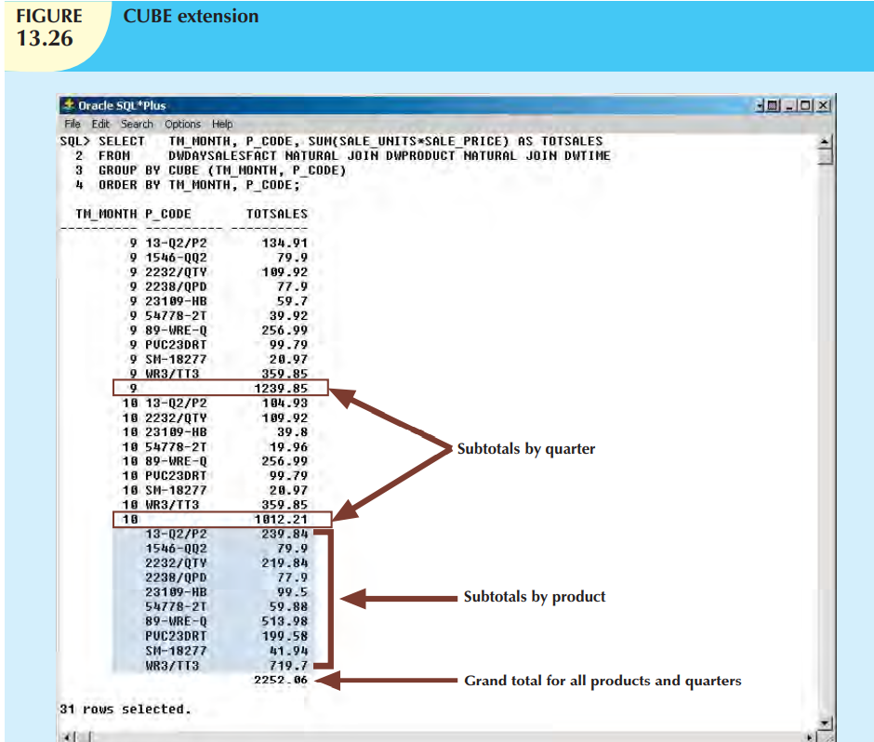
Use of the CUBE extension to compute the sales subtotals by month and by product, as well as a grand total

Slide 81
SQL EXTENSIONS FOR OLAP
Materialized view: A materialized view is a dynamic table that not only contains the SQL query command to generate the rows, but also stores the actual rows.
The materialized view is created the first time the query is run and the summary rows are stored in the table.
The materialized view rows are automatically updated when the base tables are updated.
The OLAP end user can create OLAP queries, using the standard fact tables, and the DBMS query optimization feature will automatically use the materialized views if those views provide better performance.

Slide 82
SQL EXTENSIONS FOR OLAP
Materialized view (contd…)
The basic syntax for the materialized view is:
CREATE MATERIALIZED VIEW view_name
BUILD {IMMEDIATE | DEFERRED}
REFRESH {[FAST | COMPLETE | FORCE]} ON COMMIT
[ENABLE QUERY REWRITE]
The BUILD clause indicates when the materialized view rows are actually populated.
IMMEDIATE indicates that the materialized view rows are populated right after the command is entered.
DEFERRED indicates that the materialized view rows will be populated at a later time. Until then, the materialized view is in an “unusable” state.

Slide 83
SQL EXTENSIONS FOR OLAP
Materialized view (contd…)
The REFRESH clause lets you indicate when and how to update the materialized view when new rows are added to the base tables.
FAST indicates that whenever a change is made in the base tables, the materialized view updates only the affected rows.
COMPLETE indicates that a complete update will be made for all rows in the materialized view when the select query on which the view is based is rerun.
FORCE indicates that the DBMS will first try to do a FAST update; otherwise, it will do a COMPLETE update.
The ON COMMIT clause indicates that the updates to the materialized view will take place as part of the commit process of the underlying DML statement.
The ENABLE QUERY REWRITE option allows the DBMS to use the materialized views in query optimization

Slide 84
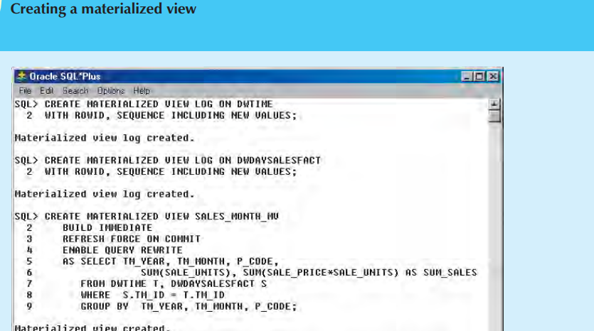

Slide 85
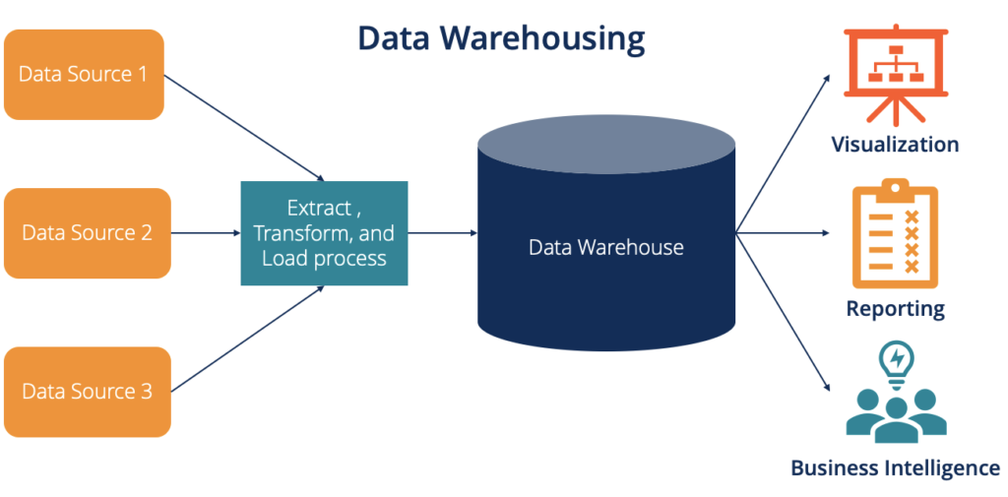

Slide 86
End of Unit 6

